Slide 1

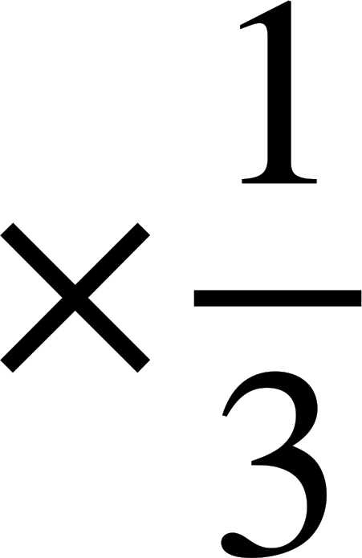
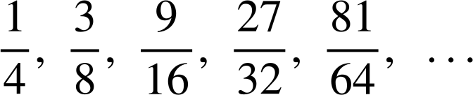
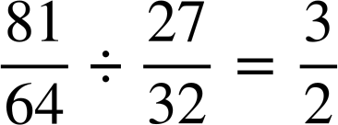
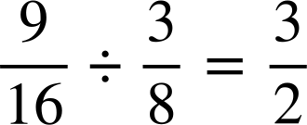

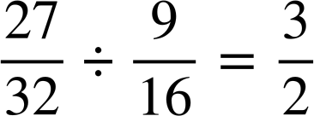
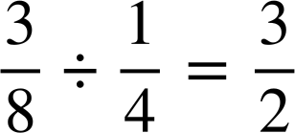
Recognising geometric sequences
Task A: Finding the common ratio
1) Divide each term by the previous term to find the common ratio in each of these geometric sequences.
a) | 15, | 105, | 735, | 5145, | 36 015, | …
36 015 ÷ 5145 = 7
×7
×7
×7
×7
5145 ÷ 735 = 7
735 ÷ 105 = 7
105 ÷ 15 = 7
b) | 0.08, | 0.72, | 6.48, | 58.32, | 524.88, | …
524.88 ÷ 58.32 = 9
×9
×9
×9
×9
58.32 ÷ 6.48 = 9
6.48 ÷ 0.72 = 9
0.72 ÷ 0.08 = 9
c) | 567, | 189, | 63, | 21, | 7, | …
7 ÷ 21 =
21 ÷ 63 =
63 ÷ 189 =
189 ÷ 567 =
d)

Slide 2





Recognising geometric sequences
2) a) This sequence is geometric. Show that it is and write a sentence to justify why it is.
768, 576, 432, 324, 243, …
243 ÷ 324 =
432 ÷ 576 =
324 ÷ 432 =
576 ÷ 768 =
The sequence has a common ratio of between successive terms therefore is geometric.
÷192
768 | : | 576
4 | : | 3
576 | : | 432
4 | : | 3
432 | : | 324
4 | : | 3
324 | : | 243
4 | : | 3
÷192
You might also have said…
The sequence has a constant ratio of 4 : 3 between successive terms therefore is geometric.
Remember that the common ratio should be given as a single value though.
÷144
÷144
÷108
÷108
÷81
÷81
b) This sequence is not geometric. Show that it is not and write a sentence to justify why it is not.
756, 252, 126, 42, 21, …
21 ÷ 42 =
126 ÷ 252 =
42 ÷ 126 =
252 ÷ 756 =
The sequence has a multiplicative relationship of between some terms and between others therefore is not geometric.
÷252
756 | : | 252
3 | : | 1
252 | : | 126
2 | : | 1
126 | : | 42
3 | : | 1
42 | : | 21
2 | : | 1
÷252
You might also have said…
÷126
÷126
The sequence has a ratio of 3 : 1 between some terms and 2 : 1 between others therefore is not geometric.
÷42
÷42
÷21
÷21

Slide 3




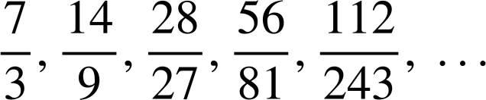

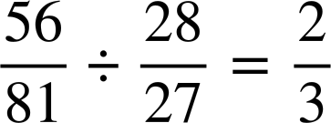
Recognising geometric sequences
Task B: Using the common ratio
1) Find the missing terms in these geometric sequences.
a)
, | 17, | 51, | 153, | 459, | …
b)
1125, | 225, | 45, | 9, | , | …
×3
×3
×3
×3
153 ÷ 51 = 3
45 ÷ 225 =
c)
0.007, | 0.14, | 2.8, | 56, | 1120, | …
d)
×20
×20
×20
×20
2.8 ÷ 0.14 = 20
2) Find the two possible geometric sequences given these missing, non-successive terms.
1st | 2nd | 3rd | 4th | 5th
4 | 20 | 100 | 500 | 2500
4 × r × r = 100
4 × r² = 100
×5
×5
×5
×5
r² = 25
r = 5 or −5
1st | 2nd | 3rd | 4th | 5th
4 | −20 | 100 | −500 | 2500
×−5
×−5
×−5
×−5
Mathematics in Education and Industry.
v2.3

